Slide 1
Composition
(Sub)System
Component
Composition
Composition
Comp-
onent
Comp-
onent
Comp-
onent
Comp-
onent
Comp-
onent
Component
Component
Endogenous Binding
(Instance-Level Composition)
e.g. SOFA 2, BIP
Exogenous Binding
(Type-Level Composition)
e.g. Autosar, Spring

Slide 2
Port
 | Port Type | Graphical Representation
 |  | Required Port | Provided Port
Operation Interface | Request-Response Port
Data Interface | Sender-Receiver Port
Event | Event Port
Life-Cycle Event | Life-Cycle Port
Data Area Mapping | Mapping Port

Slide 3



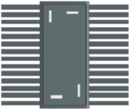
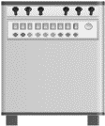
Workflow
CM
A
C
OEM
A
B
C
IWD.xml
A
B
HW Arch.
Component Types
（Binary）
SW Arch.
S
S
S
S
Run-time
(Component Instances)
Pick up
A
Vendor
a
b
A
B
C
D
E
Component Type Repository
(Component Store)
CTD.xml
CTD: Component Type Definition
IWD : Instance Wiring Description

Slide 4
Design Phase
Deployment Phase
Run-time Phase
Builder
(Vendor)
Repository
(Vendor)
Shared
Repository
Modeler
(OEM)
Distributed
RTE
(OEM)
Modeler
(OEM)
Hardware
Arch
A
A
A
A
insA
insA’
deposit
upload
compile
instantiate
update
Software
Arch
B
B
B
insB
CTD.xml
insB
CTD.xml
IWD.xml
CRD.xml
CTD.xml
unload
C
C
C
CD
insCD
IAD.xml
retrieve
D
D
D
E
insE
CTD: Component Type Description
Third-party
Software
IWD : Instance Wiring Description
CD
CD
insF
deposit
load
component
(binary)
component
instance
composite
instancebus
A
component
A
insA

Slide 5
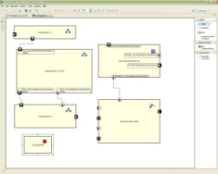

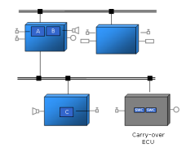
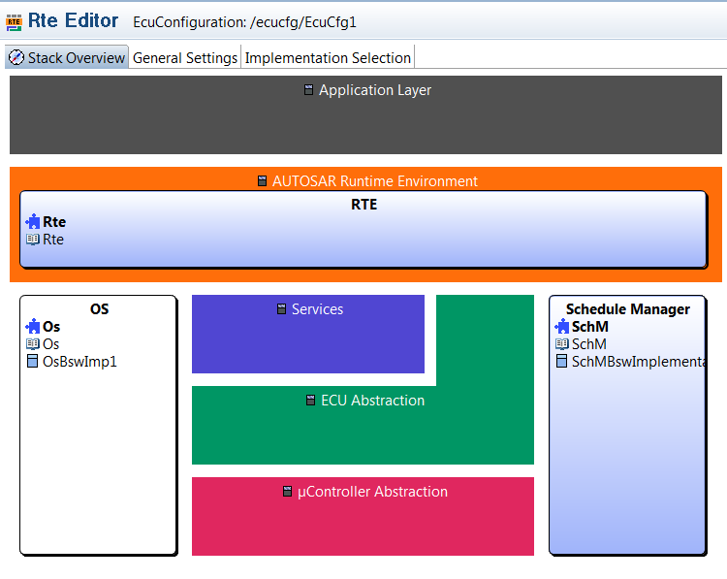
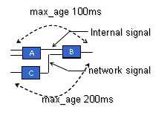
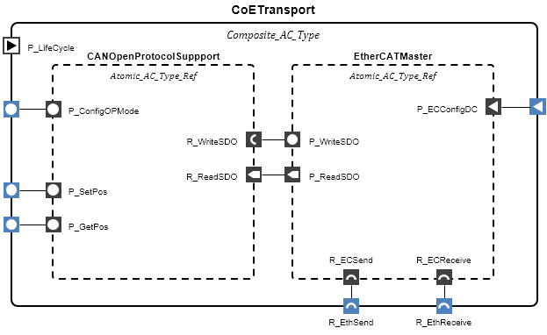
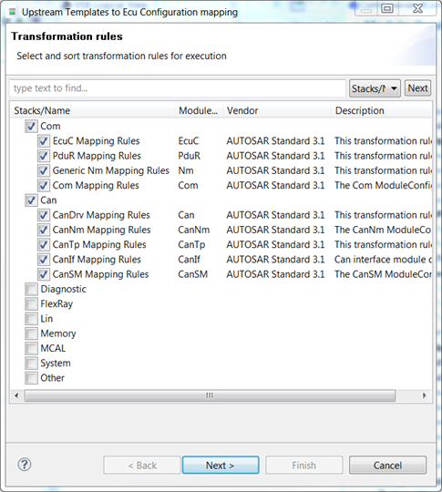
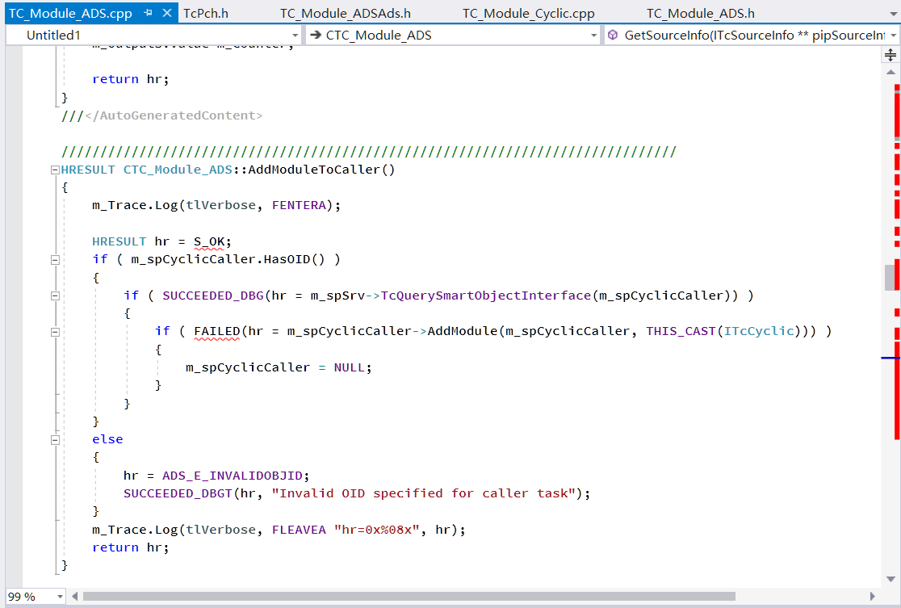
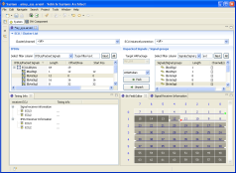
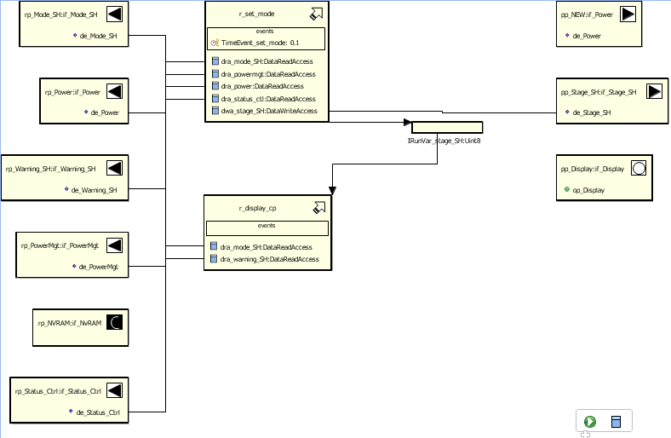
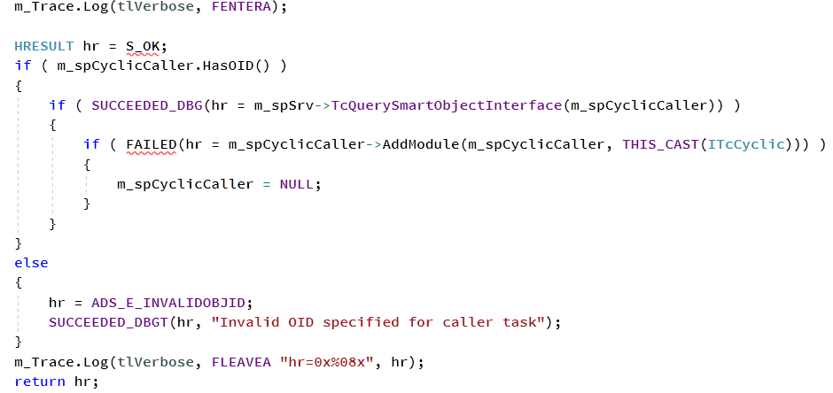
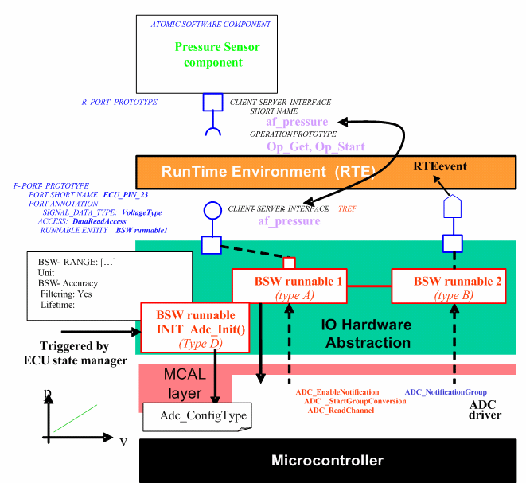
Workflow
A
B
C
HW
Specification
Component Types
(Binary)
OEM
HW architecture
definition
SW architecture
definition
RTE Components
Configuration
SW to HW arch.
mapping
Compile
&
Download
Modeler
IWD.xml
Instance Wiring Description
CTD.xml
A
B
C
Instantiate
&
Assemble
Component
Type Editor
XML-based
Interface Definition
Template Code
Generator
Component Type
Definition
D
E
F
Run-time
（IoC Container）
Component Manager
Vendor
Import
Insert
A
B
C
……
A
C
Component Types
A
B
OSAI
Component Store
Composition
Validation
Internal
Functionality
S
S
S
S
IEC Development
Tools

Slide 6
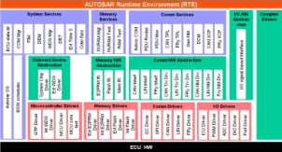
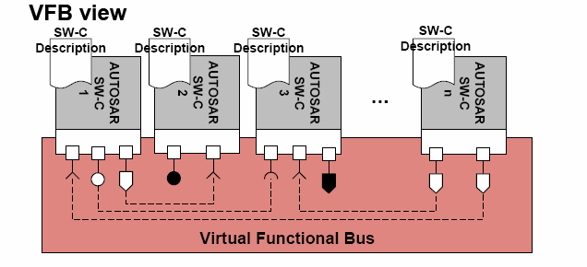
ECU
Extract
OEM
SW architecture
definition
HW architecture
definition
SW to HW arch.
mapping
Network design
CAN LIN FR, Ethernet
OEM Architects, System and ECU teams
Network Design
Configuration of
Memory, RTE
RTOS, DIAG, CAN,
LIN, FR…
UTM - Upstream Template Mapper
IOHW & Services
generation
Internal
behaviour
Additional
SWCs
ECU
Supplier
SW Validation
Configuration
genrators
BSW Integration
Compiler - linker

Slide 7
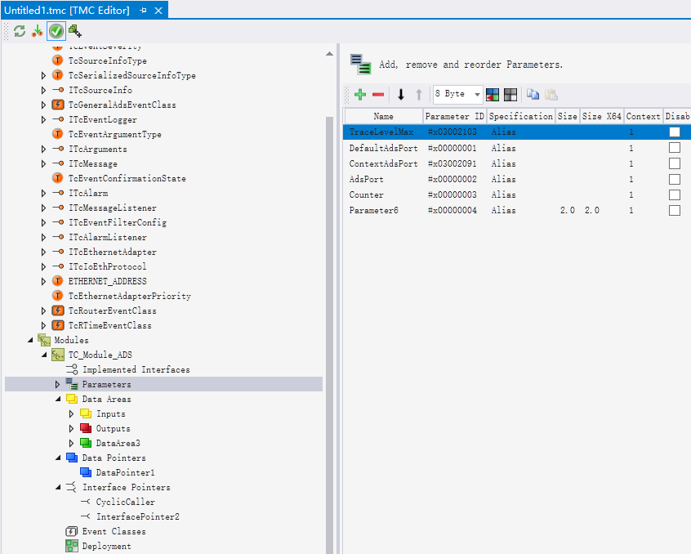
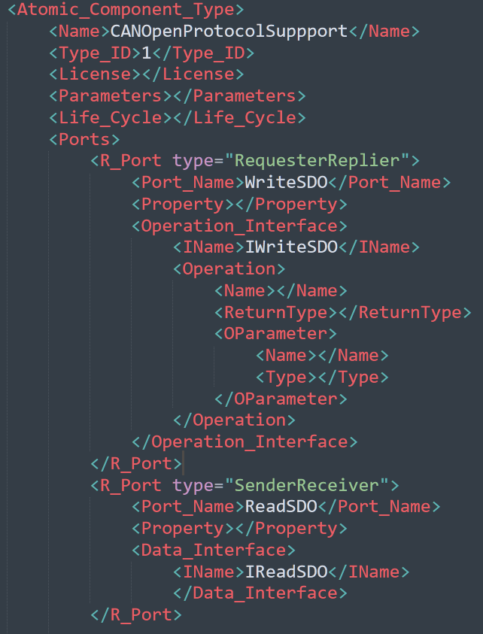
Component Type Definition
Component Type
Editor
CoETransport
P_LifeCycle
Composite_AC_Type
CANOpenProtocolSuppport
EtherCATMaster
Atomic_AC_Type_Ref
Atomic_AC_Type_Ref
P_ConfigOPMode
P_ECConfigDC
R_WriteSDO
P_WriteSDO
Component Type
Composition
P_SetPos
R_ReadSDO
P_ReadSDO
P_GetPos
R_ECSend
R_ECReceive
CTD.xml
R_EthSend
R_EthReceive

Slide 8
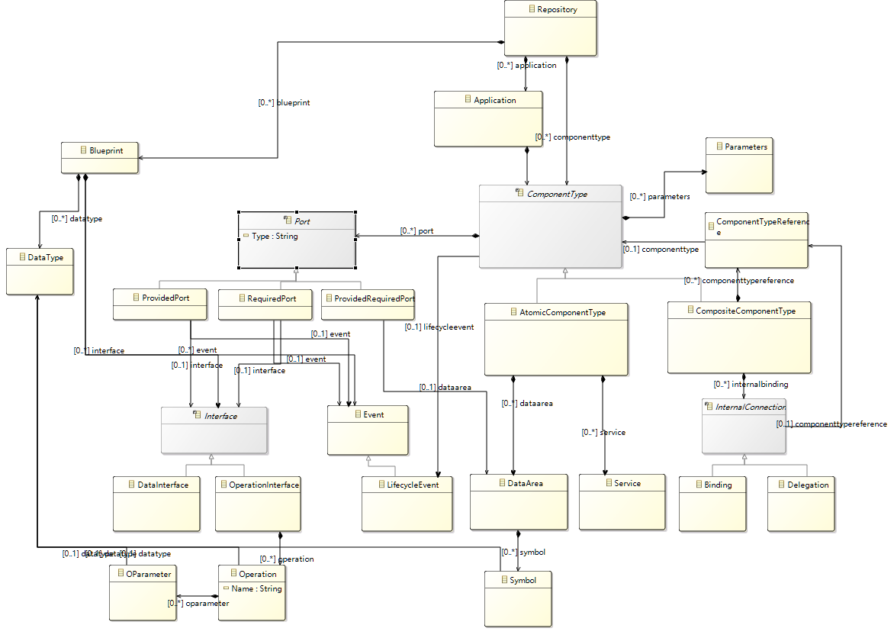

Slide 9
LifeCycle
1
2
3
9
INIT
LOADED
READY
ACTIVE
UPDATED
6
5
4
7
8
DELETED
DEACTIVE
BLOCKED
PARALLEL
组件实例化，参数初始化；组件通过Dynamic Linking加载，并在Component Manager注册其提供的interface
查询Component Manager，获取所需的interface，并建立组件间路由连接（Local routing, DCPS writer/reader）
Service绑定task，并开始运行。
停止接收新的调用和通信，等待当前调用执行完成并返回。
调用执行完成，释放资源，解绑task。
注销Component Manager中注册的Interface，卸载组件。
阻塞新的调用和通信，等待当前调用执行完成并返回。
解绑task，更换新的component实例，将之前的引用重定向至新版本的组件，并重新建立连接
唤醒步骤⑦中阻塞的调用和通信，重新绑定task 并开始运行。

Slide 10
Dynamics
Level 1：Parametric modification
动态修改组件实例的property（或数据区域）
Level 2：Instance replacement
动态替换组件实例，不更改其暴露接口和原连接关系
Level 3：Interface redirection
动态更改组件接口绑定
Level 4： Architectural reconfiguration
动态增加或者删除组件实例（或type）

